Slide 1
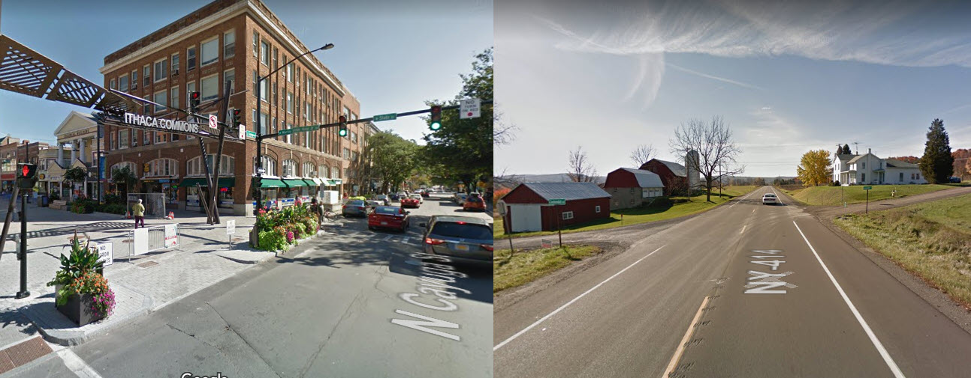
Developing a Business Model for Mobility-as-a-Service
Serving Small Urban & Rural Communities
Notes:
104 population. Regional economic growth center based on Higher Education, Manufacturing & Hi Tech, Tourism, Health Care & Agriculture

Slide 2
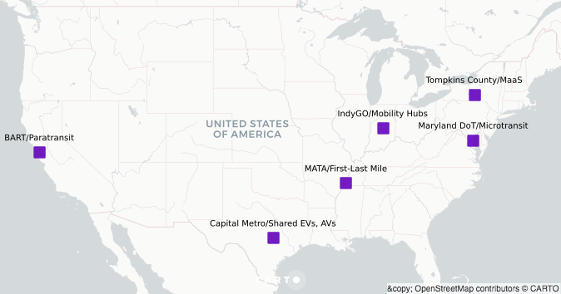
In 2018, Tompkins County’s MaaS proposal was selected for FTA’s Mobility on Demand On-Ramp Program.
Notes:
The On-Ramp program provides technical assistance through the Shared Use Mobility Center of Chicago to create a business model for a Maas pilot project.

Slide 3
Value Propositions
MaaS
Financial Services
Customer Services
Innovation & Adaptation
Member Organization
Mobility Education

Slide 4
Family of Mobility Services
Notes:
25 services

Slide 5
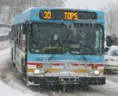
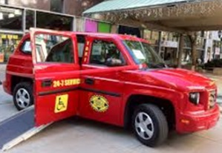
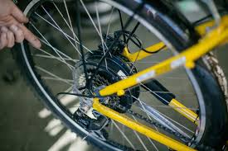
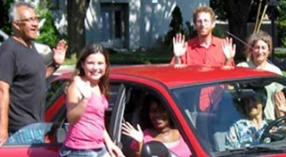
Mobility Menu | Unit Cost | Unit
Annual Adult Bus Pass | $ 450 | Annual
Annual Youth Bus Pass | $ 110 | Annual
Ithaca Carshare "Its my car" Plan | $ 8 | Hour
Ithaca Carshare "Just in Case" Plan | $ 11 | Hour
Car Rental | $ 55 | Day
Taxi trip - City | $ 8 | Urban Trip
Taxi trip - Rural | $ 20 | Rural Trip
Bicycle Maintenance | $ 50 | Voucher
Electric Bike Purchase | $ 2,000 | HE Bike
Bike Purchase | $ 700 | Bike
Rideshare Driver – Miles | $ 0.54 | Mile
Rideshare Rider – Miles | $ 0.15 | Mile
GADABOUT Paratransit | $ 4 | Trip
Vanpool Membership | $ 125 | Month/Seat
Guaranteed Ride | $ 30 | Annual

Slide 6
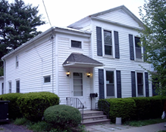
Small City Household 1 car, 2 adults, 1 youth, Walkscore = 96
Small City Family Mobility Budget
Carshare | $ 900
Annual Bus Passes (2) | $ 560
Taxi | $ 192
Bicycle Maintenance | $ 100
Guaranteed Ride | $ 30
Member Support | $ 178
Annual Total | $ 1,960
Monthly Payment | $ 163

Slide 7
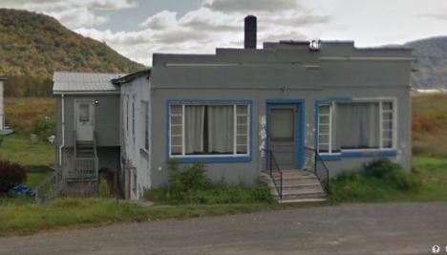
Rural Household 1 car, 2 adults, 1 child, Walkscore = 0
Rural Family Mobility Budget
Vanpool Membership | $ 1,500
Carshare (Discount Plan) | $ 480
Taxi | $ 200
Guaranteed Ride | $ 30
Member Support | $ 121
Volunteer Driver Revenue | $ (400)
Vanpool Program Subsidy | $ (600)
Total | $ 1,331
Monthly Payment | $ 111
Notes:
Rural household. Walkscore =0. No bus service.
Volunteer driver revenue works out to 37 one-trips per year.

Slide 8
Value Propositions
Mobility Education
Member Organization
Member recruitment
Governance/ Operations
Financial Services
Individual Mobility Plans, estimates of annual use & budget
Monthly Budget Billing or Single Payments
Coordinate Fare Payment with mobility operators & customers
Streamline how Public agencies purchase travel for clients
Credit volunteer driver mileage reimbursements as revenue
Credit employer subsidies as revenue
Customer Service
Concierge Service 24/7 & Guaranteed Ride
Feedback to mobility operators
Business Co-Marketing & Discounts
Capacity to adapt & innovate
Increase supply of volunteers & rideshare drivers

Slide 9
An Incomplete list of Critical Issues
MaaS Organization
Mobility Payment Methods
Public Sector transactions, orders & payments
Mobility Sales & Budget Billing
Process payments to service providers
Member recruitment and customer service
Trip Management, Referral & Fulfillment
Customer Experience Mapping
Concierge Service & Guaranteed Ride 24/7
Marketing, Business Co-Marketing & Discounts
Technology Strategy – Smartphone Apps + vehicle location/arrivals + customer notifications
Continuous improvement of mobility services

Slide 10
A good idea needs a process to develop, refine and adapt as a business model.

Slide 11
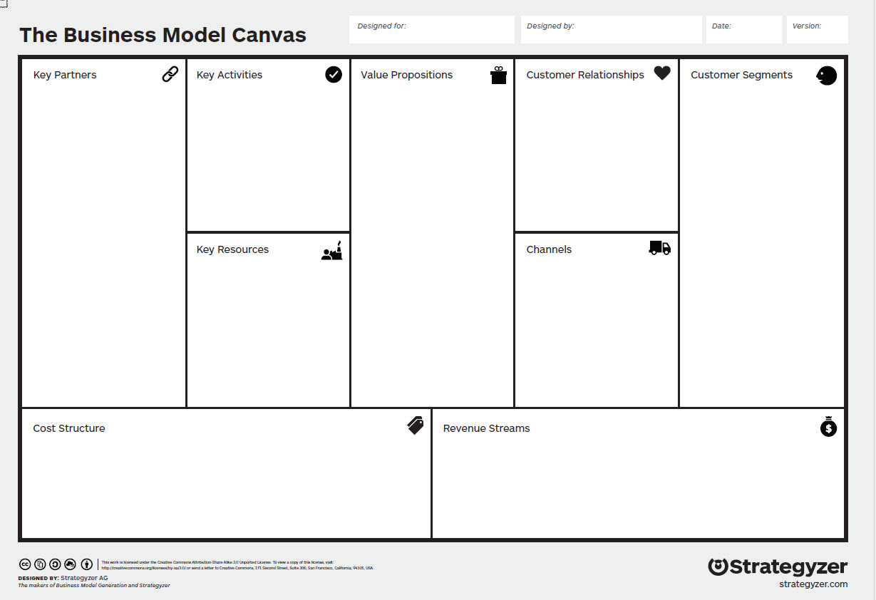
Getting from Business Idea to Business Model
https://strategyzer.com/

Slide 12
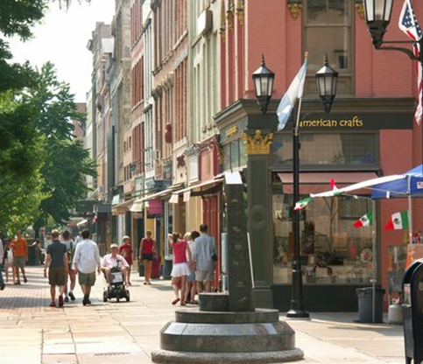
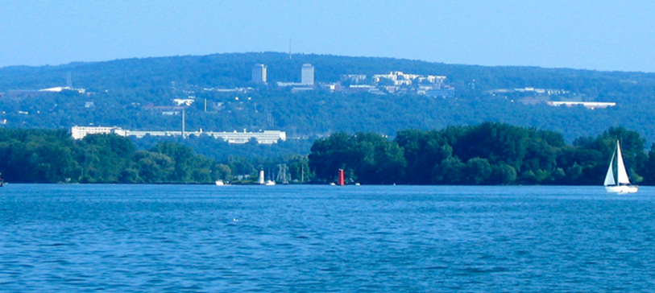
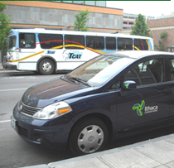
Dwight Mengel, Chief Transportation Planner
Tompkins County Dept of Social Services
Ithaca, NY
607-274-5605
dwight.mengel@dfa.state.ny.us

Slide 13
References
Subject | URL
Business Model Canvas - Strategyzer | https://strategyzer.com/
Mobility-as-a-Service (MaaS Alliance) | https://maas-alliance.eu/
MaaS Global (Finland, UK) Whim App | https://maas.global/
Way2Go Community Mobility Education | http://ccetompkins.org/community/way2go
Housing + Transportation Cost Index | https://htaindex.cnt.org/map/
Tompkins Co. H+T Index | http://ccetompkins.org/community/way2go/true-cost-tompkins
ESRI Tapestry Segmentation | http://www.esri.com/landing-pages/tapestry
Regional Mobility Management | https://www.movetogetherny.org
Ithaca Carshare (community non-profit) | http://www.ithacacarshare.org/
TCAT Public Transit System | https://www.tcatbus.com/
Tompkins County Coordinated Transportation Planning | http://www.tccoordinatedplan.org/
National Center for Mobility Management | http://nationalcenterformobilitymanagement.org/

