Slide 1
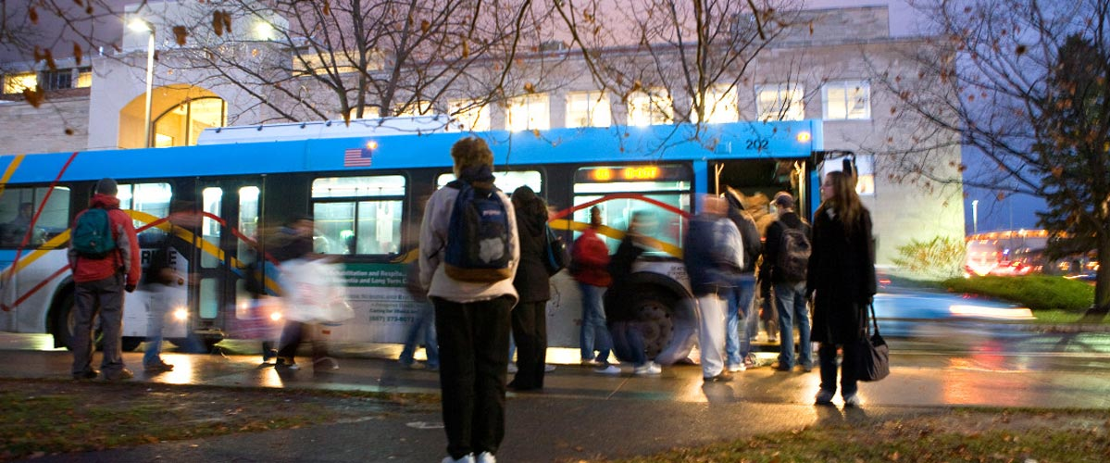
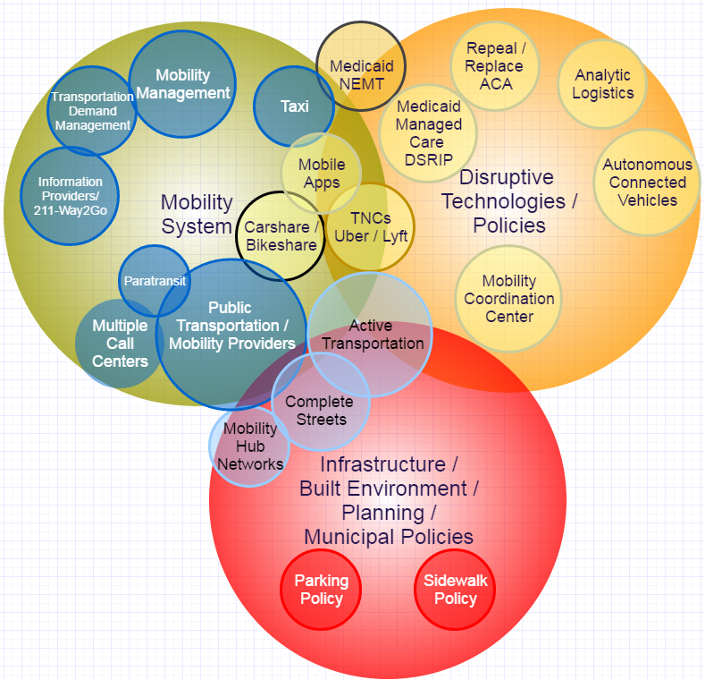
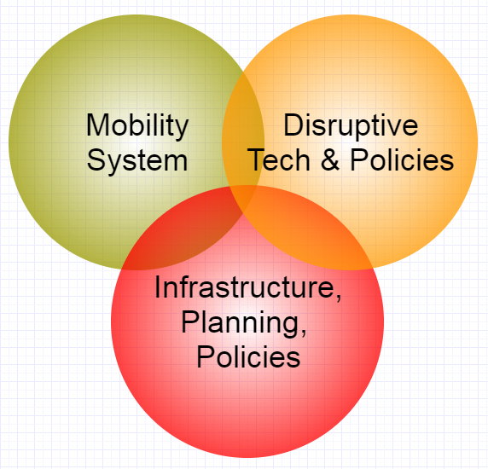
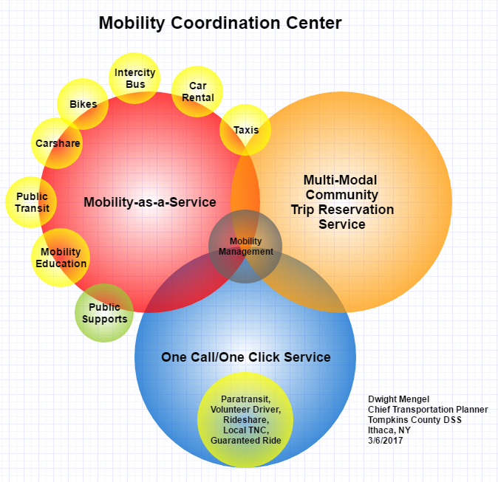
Mobility Coordination Center Concept
Dwight Mengel, Chief Transportation Planner
Tompkins County Dept. of Social Services, Ithaca, NY
BACKGROUND
THE MOBILITY ECOSYSTEM
ROLE OF MOBILITY MANAGEMENT
Tompkins County Population: 104,871 (2016)
Economy: Higher Education, Manufacturing & High Tech, Health Care, Tourism & Agriculture.
Mobility Services (June 2017):
- Public Transit: 52 buses, 4 million passengers
- Paratransit: 28 buses, 60,000 passengers
(5) Taxis, Livery & Limo Companies
(2+) Volunteer Driver Services
- Non-profit Carshare Company
- Regional Rideshare Program
(2) Commuter Bus routes from other counties
(5) Intercity Bus Services
- Bikeshare
(3+) Car Rental Companies
(2) Potential TNC’s in 2017 (Uber & Lyft)
Information Services (June 2017):
1-Call/1-Click – No centralized trip reservations
- Consumer Mobility Information Program
2-1-1 Information & Referral
- Regional Mobility Management Program
(2) Smartphone Apps – transit & taxi
Collaboration:
- Metropolitan Planning Organization (ITCTC)
- Coordinated Transportation Committee
- County Mobility Management Program
- Advocacy for walking/biking, bike repair & festivals
- Network of Mobility Services, Higher Education, Municipal, Non-Profit Agencies and Citizens
- Working Group on Transportation Equity & Reducing Environmental Impacts
- Working Group on re-entry of former inmates
- Working Group on transportation equity for rural & low-income school pupils
Consider the Mobility Ecosystem as three parts – the current Mobility System (Green) operates on Infrastructure (Red) - streets, built- environment, plans and public policies. The third element is Disruptive Technologies and Policies. (Orange), which surface on the horizon and impact the Mobility System.
Mobility Management is the heart of the Center Concept. The focus is to enable individual customer mobility. By doing so, you quickly learn the strengths, weaknesses and gaps in a mobility system. By necessity, a Mobility Manager needs to collaboratively work to increase the supply and overall performance of mobility services.
Trip failures happen every day. They need to be addressed, not ignored. Mobility Management’s individual customer-centric focus is a powerful tool for ensuring high standards of customer service.
Mobility services can fulfill multiple roles. An example is carshare . It’s primary purpose is to enable individuals or businesses to share cars. Carshare can also enable human service agencies to provide volunteer driver services, as all operating costs , including fuel and insurance, are covered in the membership, hourly and mileage rates.
In the Age of Disruption, new mobility services, technologies and public policies will change the current mobility system. The challenge is to integrate positive elements of disruption, while reducing negative impacts. Our goal is to radically improvement in customer service while operating equitable and sustainable community mobility services. A new service model, the Mobility Coordination Center, is discussed below.
Mobility Coordination Center
One-Call/One Click Center + Operations
Provide information
Manage trip reservations
Operate demand response, shared ride services & guaranteed ride.
Mobility-as-a-Service (MaaS)
Resell bundles of mobility services to customers at a monthly price or per ride fee.
Resolve trip failures & complaints
Include public sector supports and trip purchasing (i.e. Dept. of Social Services)
Multi-model Community Trip Reservations
Enable customers to book rides on existing trips by multiple operators & services. Goal is to fill empty seats. An example is QRyde. (Qryde.com)
NEXT STEPS
Create a Business Model & Development Plan
Find an Organizational Home
Conduct a Feasibility Study
Plan and Implement a Pilot Project – Phase 1
Plan and Implement an Urban Pilot Project – Phase 2
Plan and Implement a County-wide Deployment
Plan and Implement a Regional Deployment
RESOURCES AND CONTACT INFORMATION
Dwight.Mengel@dfa.state.ny.us
www.Way2Go.org
www.MoveTogetherNY.org
www.TCCoordinatedPlan.org
www.tcatbus.com
https://gadaboutbus.org/
www.NYMobilityManager.org

